Slide 1

Subscribe to DeepL Pro to edit this document.
Visit www.DeepL.com/pro for more information.

Slide 2


Fundamentals of multilayer architecture
Intelligent Infrastructure Design for the Internet of Things
Antonio Navarro

Slide 3
Index
References
Introduction
Single-layer architecture
  Features
  Advantages and disadvantages
Two-layer architecture
  Features
  Advantages and disadvantages
  Related patterns

Slide 4
Index
Multilayer architecture
  Features
  Advantages and disadvantages
  Related patterns
Front controller pattern
Application Controller Pattern
MVC Pattern

Slide 5
Index
Transfer pattern
Data Access Object Pattern
Application service pattern
Pattern subject of business
Domain store pattern
Conclusions

Slide 6
References
Alur, D., Malks, D., Crupi. J. Core J2EE Design Patterns: Best Practices and Design Strategies. 2nd Edition. Prentice Hall, 2003
Fowler, M. Patterns of Enterprise Application Architecture. Addison-Wesley, 2002
Java Platform Enterprise Edition 7 Tutorial https://docs.oracle.com/javaee/7/tutorial/index.html

Slide 7
Introduction
In this topic we will look at the fundamentals of multilayer architecture.
It is a basic architecture for the design of applications with important integration needs.

Slide 8
Introduction
We will not worry about obtaining good designs at the component level of each layer.
This is dealt with by disciplines such as:
  Human-computer interaction
  Programming
  Design patterns
  Databases

Slide 9
Introduction
We will take care of quality from an architectural point of view.
Architecture* is the fundamental organization of a system, expressed in its components, their relationships with each other, and in the environment and principles that guide its design and evolution.
IEEE Std 1471-2000 IEEE Recommended Practice for Architectural Description of Software-Intensive Systems

Slide 10
Introduction
In particular, we will look at the multilayer architecture and its fundamental patterns.
  The catalog contains 21 patterns
  We will see a basic multilayer with 4 patterns
Although these patterns are drawn from web engineering*, they are also applicable to non-web applications.
*http://www.corej2eepatterns.com/index.htm

Slide 11
Introduction
According to Christopher Alexander, "a pattern describes a problem that occurs over and over again in our environment, as well as the solution to that problem in such a way that you can apply this solution a million times, without doing the same thing twice".

Slide 12
Introduction
Although Alexander was referring to patterns in cities and buildings, what he says is also valid for OO design patterns.
We can say that the design patterns:
- They are simple and elegant solutions to specific OO software design problems.
- They represent solutions that have been developed and have evolved over time.

Slide 13
Introduction
Design patterns do not take into account issues such as:
- Data structures
- Domain-specific designs
They are descriptions of classes and related objects that are particularized to solve a general design problem in a given context.

Slide 14
Introduction
Each design pattern identifies:
- Participating classes and instances
- Roles and collaborations of these classes and instances
- The distribution of responsibilities

Slide 15
Introduction
Some pattern sources:
- GRASP*, by Craig Larman
- Gang of Four (GoF) patterns, by Eric Gamma et al.
- Core J2EE patterns, by Alur et al.
- Patterns of Enterprise Application Architecture, by Fowler et al.
- SOA Design Patterns, by Thomas Erl
General Responsibility Assignment Software Patterns

Slide 16
Single-layer architecture
Features
The single-layer architecture does not divide the system into presentation, business and integration.

Slide 17
Single-layer architecture
Features
System
Data
System classes

Slide 18
Single-layer architecture
Features
System behavior

Slide 19
Single-layer architecture
Advantages and disadvantages
Advantages
  Conceptual simplicity
Inconveniences
  Neither the user interface, the business logic nor the data representation can be modified without affecting the other layers.
  Factual complication

Slide 20
Two-layer architecture
Features
The two-layer architecture differentiates between the presentation layer and the rest of the system.
Does not differentiate integration business

Slide 21
Two-layer architecture
Features
Interface
Business and integration
Data
System classes

Slide 22
Two-layer architecture
Features
System behavior

Slide 23
Two-layer architecture
Advantages and disadvantages
Advantages
  Allows changes to the user interface or to the rest of the system without mutual interference
  Factual simplicity
Inconveniences
  More architectural complication than single-layer architecture
  Cannot change business logic or data representation without mutual interference

Slide 24
Two-layer architecture
Related patterns
Although not strictly necessary, it is often used:
  MVC

Slide 25
Multilayer architecture
Features
The multilayer architecture considers a presentation layer, a business layer, and an integration layer.

Slide 26
Multilayer architecture
Features
The presentation layer encapsulates all the presentation logic required to serve clients accessing the system.
The business layer provides the system services
The integration layer is responsible for communication with external resources and systems.

Slide 27
Multilayer architecture
Features
In reality, the architecture is five-tiered, as it includes the client and resource layers
The client layer represents all the devices or clients of the system that access the system. It is above the presentation layer
The resource layer contains the business data and external resources. It is under the integration layer

Slide 28
Multilayer architecture
Features

Slide 29
Multilayer architecture
Features
Interface
Business
Integration
Data
System classes

Slide 30
Multilayer archit. Features
System behavior

Slide 31
Multilayer architecture
Features
Note that these are logical layers
Physical layers are another matter
Thus, the web presentation layer and the business logic could be on the same machine or on different machines.

Slide 32
Multilayer architecture
Features
Advantages
  Any layer can be modified without affecting the others.
  Factual simplicity?
Inconveniences
  Increased architectural complexity

Slide 33
Multilayer architecture
Features
Advantages:
  Integration and reusability
  Encapsulation
  Distribution
  Partitioning
  Scalability
  Improved performance
  Improved reliability

Slide 34
Multilayer architecture
Features
  Manageability
  Increased consistency and flexibility
  Support for multiple customers
  Independent development
  Rapid development
  Packaging
  Configurability

Slide 35
Multilayer architecture
Features
Disadvantages:
  Possible loss of performance and scalability
  Security risks
  Component management

Slide 36
Multilayer architecture
Related patterns
Related patterns:
  Presentation
    Front controller
    Application Controller
    MVC
  Business
    Transfer
    Application service

Slide 37
Multilayer architecture
Related patterns
    Object of business
  Integration
    Data Access Object (DAO)
    Domain store

Slide 38
Front controller pattern
Purpose
  Provides an access point for handling requests from the presentation layer
Also known as
  Front controller

Slide 39
Front controller pattern
Motivation
  Avoiding duplicate control logic is desired
  You want to apply a common logic to different requests
  You want to separate the processing logic of the system from the view
  It is desired to have centralized and controlled access points to the system.

Slide 40
Front controller pattern
It must be applied when
  You want to have an initial point of contact for handling requests, centralizing control logic and managing request handling activities.

Slide 41
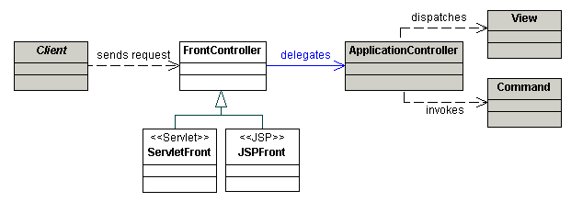
Front controller pattern
Structure
Structure of the front controller pattern

Slide 42
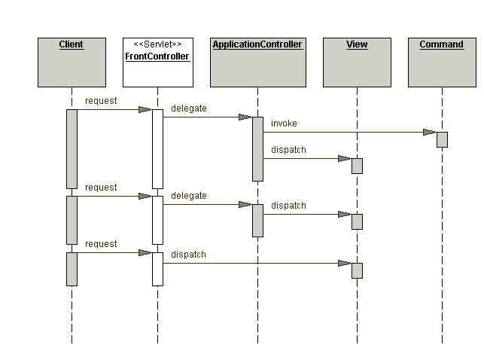
Front controller pattern
Interaction of related objects by the front controller

Slide 43
Front controller pattern
Consequences
  Advantages:
    Centralizes control
    Improved application management
    Improved reuse
    Improved separation of roles
  Inconveniences
    In large applications it can grow very large

Slide 44
Front controller pattern
Example code
public class FrontController extends HttpServlet {
protected void doGet(HttpServletRequest request,
HttpServletResponse response) throws ServletException, java.io.IOException {
processRequest(request, response);
}

Slide 45
Front controller pattern
protected void doPost(HttpServletRequest request,
HttpServletResponse response)
throws ServletException, java.io.IOException {
processRequest(request, response);
}

Slide 46
Front controller pattern
protected void processRequest(HttpServletRequest request, HttpServletResponse response) throws ServletException, java.io.IOException {
String page;
ApplicationResources resource = ApplicationResources.getInstance();
try {
RequestContext requestContext =
new RequestContext(request, response);

Slide 47
Front controller pattern
ApplicationController applicationController = new
ApplicationControllerImpl();
ResponseContext responseContext = applicationController.handleRequest(requestContext);
applicationController.handleResponse(
requestContext, responseContext);
} catch (Exception e) {
LogManager.logMessage("FrontController:exception : " +
e.getMessage());
request.setAttribute(resource.getMessageAttr(),
"Exception occurred : " + e.getMessage());
page = resource.getErrorPage(e);

Slide 48
Front controller pattern
dispatch(request, response, page);
}
}
// only this function is used if there is an error.
protected void dispatch(HttpServletRequest request, HttpServletResponse response, String page)
throws javax.servlet.ServletException, java.io.IOException {
RequestDispatcher dispatcher = this.getServletContext().
getRequestDispatcher(page);
dispatcher.forward(request, response);
}
}

Slide 49
Application Controller Pattern
Purpose
  We want to centralize and modularize the management of actions and views.
Also known as
  Application controller

Slide 50
Application Controller Pattern
Motivation
  You want to reuse the view and action management code.
  You want to improve the extensibility of request handling (e.g. add use cases to an application incrementally).
  Improved code modularity and maintainability is desired, facilitating application extension and testing of request handling code independently of the web container.

Slide 51
Application Controller Pattern
It must be applied when
  You want to centralize the retrieval and invocation of request processing components, such as commands and views.

Slide 52
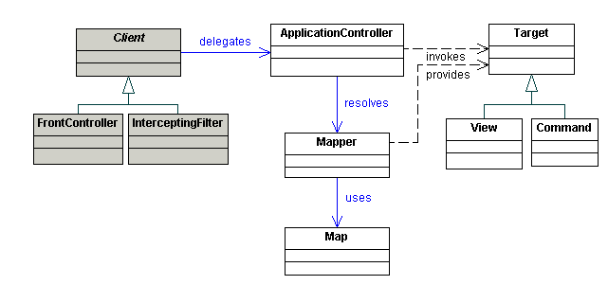
Application Controller Pattern
Structure:
Structure of the application controller pattern

Slide 53
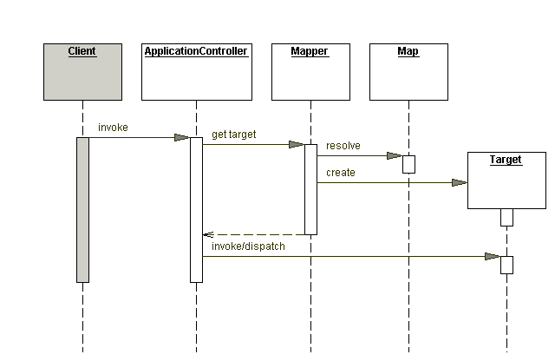
Application Controller Pattern
Interaction between related objects by application controller

Slide 54
Application Controller Pattern
Consequences
  Advantages
    Improved modularity
    Improved reuse
    Improved extensibility
  Inconveniences
    Increases the number of objects involved
    In large applications it can grow very large

Slide 55
Application Controller Pattern
Example code
interface ApplicationController
{
ResponseContext handleRequest(RequestContext requestContext);
void handleResponse(RequestContext requestContext, ResponseContext responseContext);
}

Slide 56
Application Controller Pattern
class WebApplicationController implements ApplicationController
{
public ResponseContext handleRequest(RequestContext requestContext)
{
ResponseContext responseContext = null;
try {
String commandName = requestContext.getCommandName();

Slide 57
Application Controller Pattern
CommandFactory commandFactory = CommandFactory.getInstance();
Command command = commandFactory.getCommand(commandName);
CommandProcessor commandProcessor = new CommandProcessor();
responseContext = commandProcessor.invoke(command,
requestContext);
} catch (java.lang.InstantiationException e) {
} catch (java.lang.IllegalAccessException e) {
}
return responseContext; }
. . . }

Slide 58
MVC Pattern
In some frameworks the front and application controller are merged.
Let's look at a more classic MVC
The Model View Controller MVC pattern/architecture divides an interactive application into three components:
- The model contains the basic functionality and data.
- The views display/gather information to/from the user.
- Controllers mediate between views and model

Slide 59
MVC Pattern
The MVC pattern has two variants:
  Active model
  Passive model

Slide 60
MVC Pattern
Participants in MVC. Active model:
Participants in MVC. Active model

Slide 61
MVC Pattern
Interaction in MVC. Active model:
Interaction in MVC. Active model

Slide 62
MVC Pattern
Participants in MVC. Passive model:
Participants in MVC. Passive model

Slide 63
MVC Pattern
Interaction in MVC. Passive model:
Interaction in MVC. Passive model

Slide 64
MVC Pattern
Advantages:
  Model independent of output representation and input behavior
  There can be multiple views for the same model
  Independent interface/logic changes
Disadvantages:
  Complexity

Slide 65
MVC Pattern
Example code*:
class Vista extends JFrame implements IVista {
JTextField value;
JButton sum;
public Vista(Model model)
{…………………………
sum= new JButton ("+");
ActionListener controller=
new Controller(model);
sumar.addActionListener(controller);
} ………}
Active model without using java.util.Observer

Slide 66
MVC Pattern
class Controller implements ActionListener{
............................
public void actionPerformed (ActionEvent e)
{
model.sum();
}
}

Slide 67
MVC Pattern
class Model {
int value;
IVista vista;
.................
void sum()
{ value++;
view.update(this); }
int getValue()
{ return value; }
}

Slide 68
MVC Pattern
public interface IVista {
void update(Object updated);
}

Slide 69
MVC Pattern
class Vista extends JFrame implements IVista {
..........................
public void update (Object o){
Model model= (Model) or;
Integer i= new Integer(model.getValue());
value.setText(i.toString()); }
..........................
}

Slide 70
MVC Pattern
In the previous example:
  The view that sends events to the controller is the same view that receives model/controller updates.
  Match the interface event handler and the business event handler
In general, this is unreasonable (e.g. web applications).

Slide 71
MVC Pattern
Regarding the number of controllers, there may be:
- One per event
- One per functionality/stimulus set
- One per application
Notes:
http://java.sun.com/blueprints/guidelines/designing_enterprise_applications/introduction/application_scenarios/index.html

Slide 72
MVC Pattern
Example code*
public class GUIAltaUser extends JFrame {
…………
public GUIAltaUser()
{ setTitle("User registration");
JPanel panel= new JPanel();
JLabel lName= new JLabel("Name:");
final JTextField tName= new JTextField(20);
JLabel lEMail= new JLabel("e-mail:");
final JTextField tName= new JTextField(20);
final JTextField tEMail= new JTextField(20);
JButton accept= new JButton("Accept");
JButton cancel= new JButton("Cancel");
Single controller, passive model

Slide 73
MVC Pattern
panel.add(lName);
panel.add(tName);
panel.add(lEMail);
panel.add(tEmail);
panel.add(accept);
panel.add(cancel);
getContentPane().add(panel);
pack();

Slide 74
MVC Pattern
accept.addActionListener(new ActionListener()
{ public void actionPerformed(ActionEvent e)
{ setVisible(false);
String name= tName.getText();
String eMail= tEMail.getText();
TUsuario tU= new TUsuario(nombre , eMail);
Controller.getInstance().
action(Events.ALTA_USER, tU);
}
});
……………………………
}

Slide 75
MVC Pattern
public class Event {
public static final int ALTA_USER= 101;
public static final int BAJA_USUARIO= 102;
public static final int SHOW_USER= 103;
…………
public static final RES_ALTA_USER_OK= 401;
public static final RES_ALTA_USER_KO= 402;
…………
}

Slide 76
MVC Pattern
public class Controller {
………
//this is a controller access option
//a services and GUI
//there may be more advanced ones
private SAUsUser saUser;
private IGUI gui;

Slide 77
MVC Pattern
//naif implementation of a controller table
//according to the singleton, it should be in the subclass
public void action(int event, Object data)
{ switch (event){
case EVENT.ALTA_USER: {
TUser tUser= (TUser) data;
int res= saUser.high(tUser);
if (res>0) gui.update(Event.RES_ALTA_USER_OK,
new Integer(res));
else
gui.update(Event.RES_ALTA_USER_KO, null);
break; }
case Event.UNSUBSCRIBE_USER: { ...... }
……………

Slide 78
MVC Pattern
public interface IGUI {
// we do not use java.util.Observer
//because it forces the data to be observable
void update(int event, Object data);
}

Slide 79
MVC Pattern
public class GUIBiblioteca extends JFrame implements IGUI {
private static GUIBiblioteca guiLibrary guiLibrary;
private IGUIUser guiUser;
private IGUIPublication guiPublication;
private IGUIPrestamo guiPrestamo;
private Controller controller;

Slide 80
MVC Pattern
public void update(int event, Object data)
{ switch (event)
{
case Event.SHOW_GUI_LIBRARY:
{ setVisible(true); break; }
case Event.HIDE_GUI_GUIDE_LIBRARY: { setVisible(false); break; }

Slide 81
MVC Pattern
case EventGUI.RES_ALTA_USER_OK:
{ Integer id= (Integer) data;
JOptionPane.showMessageDialog(null,
"User created with ID: "+id.intValue()); setVisible(true); break; }
case EventGUI.RES_ALTA_USER_KO:
{ JOptionPane.showMessageDialog(null,
"User could not be created"); setVisible(true); break; }
……………
}
}

Slide 82
MVC Pattern
Comments:
- The MVC pattern is a particular case of the observer pattern.
- Views in MVC can be nested. In this way a view would be a particular case of the composite pattern
- By centralizing the interaction between views, and between views and model, it is easier to change both view selection and model selection.

Slide 83
MVC Pattern
v1
v1
v1
v1
x
v2
v2
v2
v2
x
...
...
...
c
...
c
_{vi}
_{vi}
x
_{vi}
_{vi}
...
...
...
...
vn
vn
vn
vn
Changes without controller
Changes with controller

Slide 84
MVC Pattern
v1
m1
v1
m1
v1
m1
v1
m1
x
v2
m2
v2
m2
v2
m2
v2
m2
...
x
...
x
...
...
...
...
c
c
...
...
mj
mj
mj
mj
...
...
...
...
vn
_{mm}
vn
_{mm}
vn
_{mm}
vn
_{mm}
Changes without controller
Changes with controller

Slide 85
Transfer pattern
Purpose
  Independence of data exchange between layers
Also known as
  Transfer

Slide 86
Transfer pattern
Motivation
  If we want to make the layers independent, they cannot have knowledge of the representation of the entities of our system within each layer.
  For example, if we access relational databases, clients should be aware of the existence of columns in the data.

Slide 87
Transfer pattern
It must be applied when
  You do not want to know the internal representation of an entity within a layer.
Note
  As a communication mechanism between layers, they are serializable objects.

Slide 88
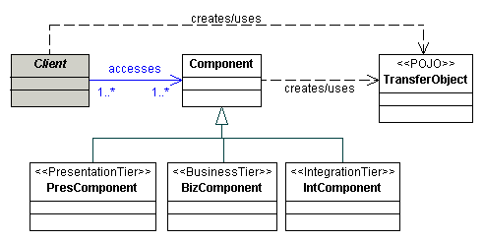
Transfer pattern
Structure
Structure of the transfer pattern

Slide 89
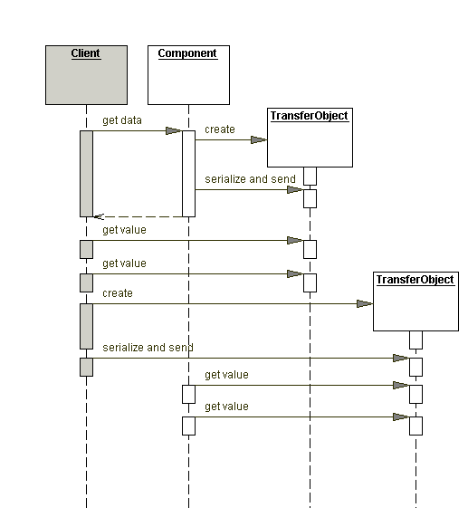
Transfer pattern
Interaction between objects related by the transfer pattern

Slide 90
Transfer pattern
Consequences
  Advantages
    Helps to make layers independent
  Inconveniences
    Significantly increases the number of objects in the system

Slide 91
Transfer pattern
Example code
public TUsuario implements Serializable {
public int id;
public String name;
public String eMail;
public boolean active;
public TUsuario(String nombre, String eMail)
{ this.id=0; this.name= name;
this.eMail= eMail; this.active= true; }
public TUsuario(int id, String nombre, String
eMail, boolean active)
{ this.id= id; this.name= name;
this.eMail= eMail; this.asset= asset; }

Slide 92
Transfer pattern
public int getId()
{ return id; }
public String getName()
{ return name; }
public String getEMail()
{ return eMail; }
public boolean getActive()
{ return active; }

Slide 93
Transfer pattern
public setId(int id)
{ this.id= id; }
public void setName(String name)
{ this.name= name; }
public void setEMail(String eMail)
{ this.eMail= eMail; }
public void setActivo(boolean activo)
{ this.asset= asset; }
}

Slide 94
Transfer pattern
public DAOUsuarioImp implements DAOUsuario {
public TUsuario read (int id)
{
//database access code
TUser user=
new TUser(id, name, eMail, active);
return user;
}
……………
}

Slide 95
DAO pattern
Purpose
  Allows you to access the data layer (resources, in general), providing object-oriented representations (e.g. transfer objects) to your clients.
Also known as
  Data access object
  Data access object

Slide 96
DAO pattern
Motivation
  Information systems (and many programs) store user data
  This data usually has a structure, which is embodied in a representation system (e.g., relational, XML).

Slide 97
DAO pattern
  Handling this data forces to:
    Know the access mechanisms of the data management system (e.g., database, operating system, etc.).
    Know the representation of data in the data management system (e.g., columns, elements, bytes, etc.).
  A business layer customer should be independent of these issues

Slide 98
DAO pattern
  Thus, the data layer could be changed without affecting the business layer. Only the integration layer, which is lighter than the business layer, would have to be updated.
It must be applied when
  You want to make data representation and access independent of data processing.

Slide 99
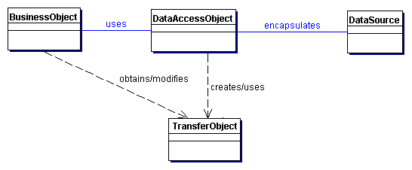
DAO pattern
Structure
DAO pattern structure

Slide 100
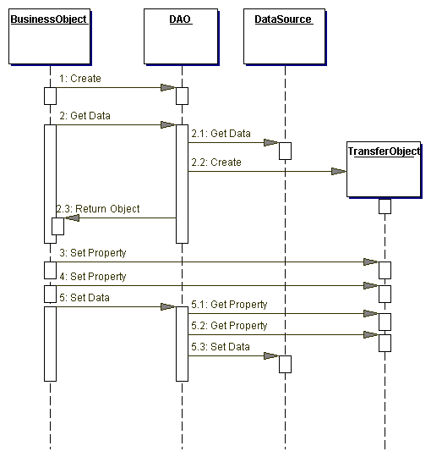
DAO pattern
Interaction between related objects by DAO pattern

Slide 101
DAO pattern
Consequences
  Advantages:
    It separates the processing of data from its access and structure.
    Allows the business layer to be separated from the data layer.
  Inconveniences
    Increases the number of objects in the system

Slide 102
DAO pattern
Let's see a simple example of a DB connection from
The code:
  Connects to a database
  Send a query
  Process the result
Intelligent Infrastructure Design for IoT- MiOT UCM Antonio Navarro

Slide 103
DAO pattern
import java.sql.*
public void connectToAndQueryDatabase(String username, String password)
{
try{
Connection con = DriverManager.getConnection(
"jdbc:myDriver:myDatabase",
username, password);

Slide 104
DAO pattern
Statement stmt = con.createStatement();
ResultSet rs = stmt.executeQuery("SELECT a, b, c FROM Table1");
while (rs.next()) {
int x = rs.getInt("a");
String s = rs.getString("b");
float f = rs.getFloat("c");
}
} finally {
if (stmt != null) pstmt.close();
if (con != null) con.close(); }
}
}

Slide 105
DAO pattern
Let's see another simple example, extracted from the same site, which makes an update
import java.sql.*;
public class UpdateCar {
public static void UpdateCarNum(int carNo, int empNo)throws SQLException {

Slide 106
DAO pattern
Connection con = null;
PreparedStatement pstmt = null;
try { con = DriverManager.getConnection(
"jdbc:default:connection");
pstmt = con.prepareStatement(
"UPDATE EMPLOYEES " +
"SET CAR_NUMBER = ? " +
"WHERE EMPLOYEE_NUMBER = ?");
pstmt.setInt(1, carNo);
pstmt.setInt(2, empNo);
pstmt.executeUpdate();

Slide 107
DAO pattern
}
finally {
if (pstmt != null) pstmt.close();
if (con != null) con.close();
}
}
}

Slide 108
DAO pattern
Example code
public interface DAOUsuario {
public int create(TUser tUser);
public TUser read(int id);
public Collection<TUser> readAll();
public TUser readByName(String name);
public int update(TUser tUser);
public int delete (int id);
}

Slide 109
DAO pattern
public class DAOUsuarioImp implements DAOUsuario {
……
public int create(TUser tUser)
{
int id= -1;
//connection to the database
PreparedStatement ps;
ps = connection.prepareStatement("INSERT INTO user (name, eMail, active) VALUES (?,?,?,?)", Statement.RETURN_GENERATED_KEYS);
ps.setString(1, tUser.getName());
ps.setString(2, tUser.getEMail());
ps.setBoolean(3, tUser.getActive());
ps.execute();

Slide 110
DAO pattern
ResultSet rs= pstmt.getGeneratedKeys();
if (rs.next())
{
res= rs.getInt(1);
}
//close connection and handle exceptions
return id;
}
………
}

Slide 111
DAO pattern
Although it is obvious in these slides, it is essential that DAOs capture and trigger the corresponding exceptions when accessing external resources.
Thus, the business layer will know what has happened if there has been some kind of access failure.

Slide 112
DAO pattern
NOTE
  Although, in general, DAOs should only have the CRUD operations (Create, Read, Update and Delete), it is possible that in a multi-tier architecture without business objects, we may need to enrich the DAOs to facilitate the management of the 1..n and m..n relations.

Slide 113

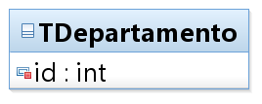
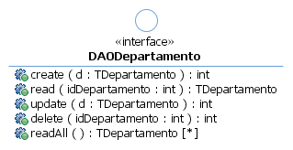
DAO pattern
  For a class:

Slide 114
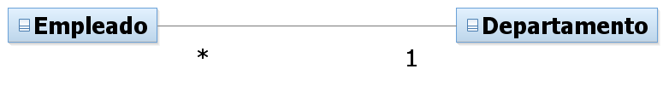
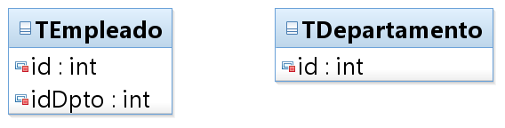
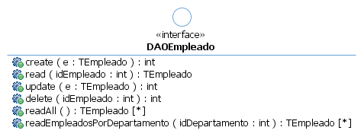
DAO pattern
  For a class, N end of a relation 1..N

Slide 115
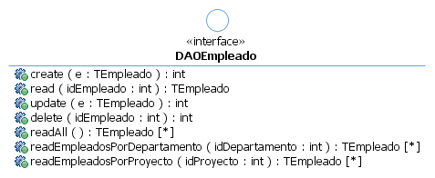
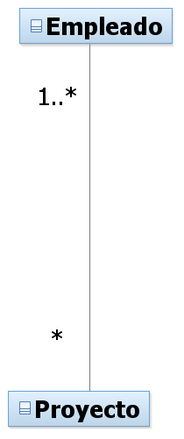
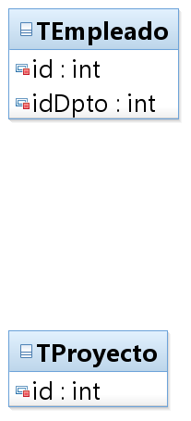
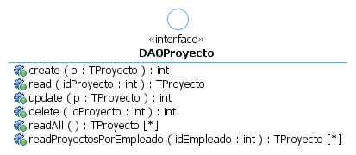
DAO pattern
  For two extreme classes of a relation M..N

Slide 116
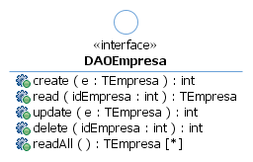
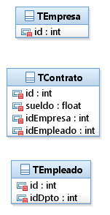
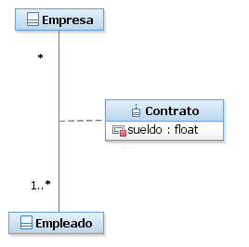
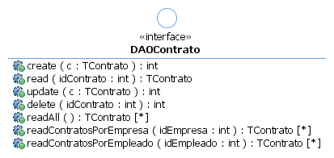
DAO pattern
  In the case of an association class, it is like two relations 1..N:

Slide 117
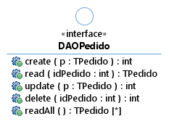
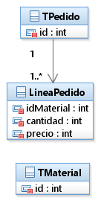
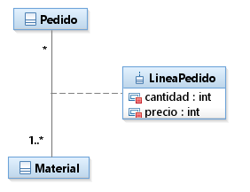

DAO pattern
  Unless we think that the intermediate class does not have sufficient entity (i.e. does not have its own ID).

Slide 118
DAO pattern
    In the latter case, if the order lines, despite not being accessed outside the order transfer, are updated frequently (e.g. due to changes in orders), it might be appropriate to give them DAO, but not application service.

Slide 119
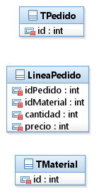
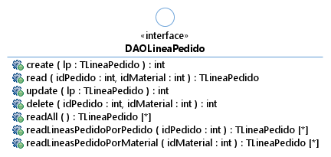
DAO pattern
  In any case, this option seems cleaner

Slide 120
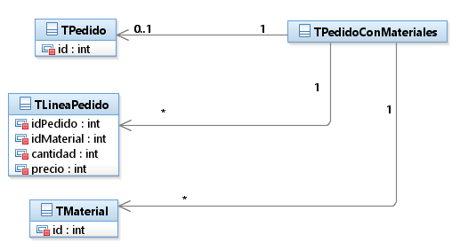
DAO pattern
    This option together with a TOA (e.g. an HS operation) would allow to read an order with its materials.

Slide 121
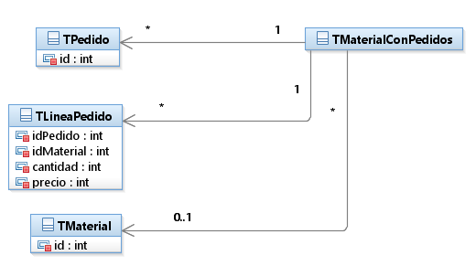
DAO pattern
    Or a material with the orders in which it appears

Slide 122
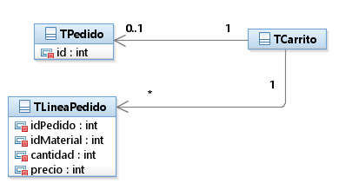
DAO pattern
    Or even a trolley

Slide 123
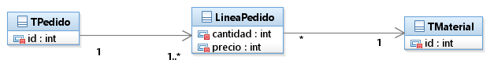
DAO pattern
  Martin Fowler is more pragmatic and would return a network of transfers created on demand from the union of use cases.
    This option however, generates networks of pruned objects in order to solve both the cycling and loading problem of all referenced elements.

Slide 124
Application Service Pattern
Purpose
  Centralizes business logic.
Also known as:
  Application service

Slide 125
Application Service Pattern
Motivation
  In a multi-tier architecture, the business logic must be somewhere.
  Putting it in the controller would couple presentation and business
  Putting it in the DAO would couple business and integration
  That is why we include it in the application services.

Slide 126
Application Service Pattern
It must be applied when
  You want to represent a business logic that acts on different business services or objects
  You want to group related functionalities
  You want to encapsulate logic that is not represented by business objects.

Slide 127
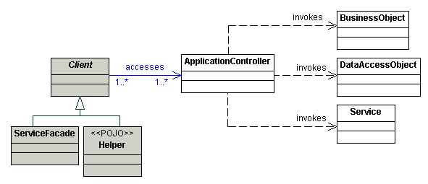
Application Service Pattern
Structure
ApplicationService
Structure of the application service pattern

Slide 128
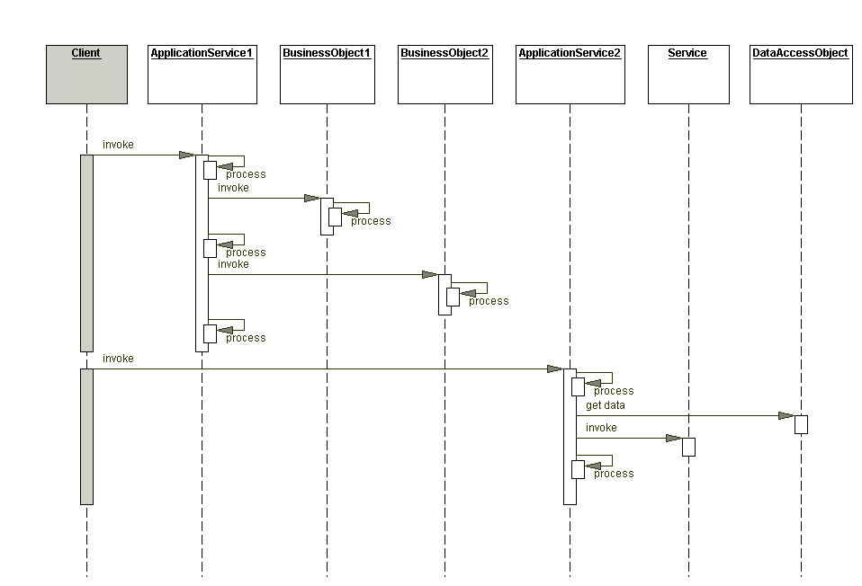
Application Service Pattern
Interaction between objects related by the application service pattern

Slide 129
Application Service Pattern
Consequences
  Advantages
    Centralizes business logic
    Improved code reusability
    Avoids code duplication
    Simplifies the implementation of facades
  Inconveniences
    Introduces one more level of indirection

Slide 130
Application Service Pattern
Example code:
public interface SAUser {
public int create(TUser tUser);
public TUser read(int id);
public Collection<TUser> readAll();
public int update(TUser tUser);
public int delete (int id);
}

Slide 131
Application Service Pattern
public class SAUsuarioImp implements SAUsuario {
public int create(TUser tUser)
{ int id= -1;
DAOUsuario daoUsuario;
if (tUser!=null)
{ //access to DAO implementation
tUser read=
daoUser.readByName(tUser.getName());
if (read==null) id= daoUser.create(tUser);
}
return id;
}
…………………………………}

Slide 132
Application Service Pattern
Note
  Although in the Core J2EE Patterns book example, application services collaborate with each other to obtain business objects (and by extension, data), this approach could complicate data consistency validations in a non-EJB multi-user environment.
  In any case, note that the application service invoked in the example (t136), does not seem to access persistent information.
Notes:
Of course, if a service is used to obtain an account, how do we know that the account we have has not changed? It would have to be blocked. Obviously, with entity EJBs there would be some way. If transfers or POJOs are used, blocking would be more difficult. If DAOs are used that make the connection to the database explicit, locking can be done from the application services.
I put this some time after the previous paragraph: see the discussion in the domain store class diagram (from the library) about this.

Slide 133
Application Service Pattern
Note
  Application services do not usually have attributes to make them lighter in weight.
  So where are the objects that have business attributes and operations?
  These objects are the business objects

Slide 134
Pattern subject of business
Purpose
  Represent business logic and domain model in object-oriented terms
Also known as:
  Business object

Slide 135
Pattern subject of business
Motivation
  When there is little or no business logic, applications can allow clients to access the data layer directly.
  Thus, a business layer component (e.g., UserImpServices) could access a DAO directly.
  However, if there are a large number of computational processes associated with the data in the client, these processes should be encapsulated in an object representing a business object.

Slide 136
Pattern subject of business
Should be applied when:
  A conceptual model with advanced validation rules and business logic is available.
  You want to separate the business logic from the rest of the application.
  You want to centralize the business logic
  You want to increase the reusability of the code

Slide 137
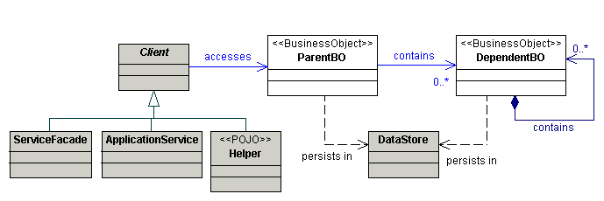
Pattern subject of business
Structure
Structure of the business object pattern

Slide 138
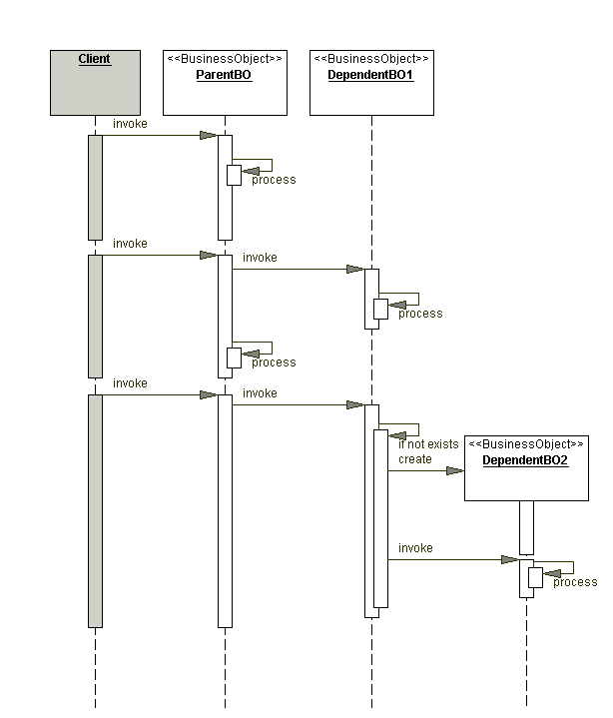
Pattern subject of business
Interaction between objects related by the business object pattern

Slide 139
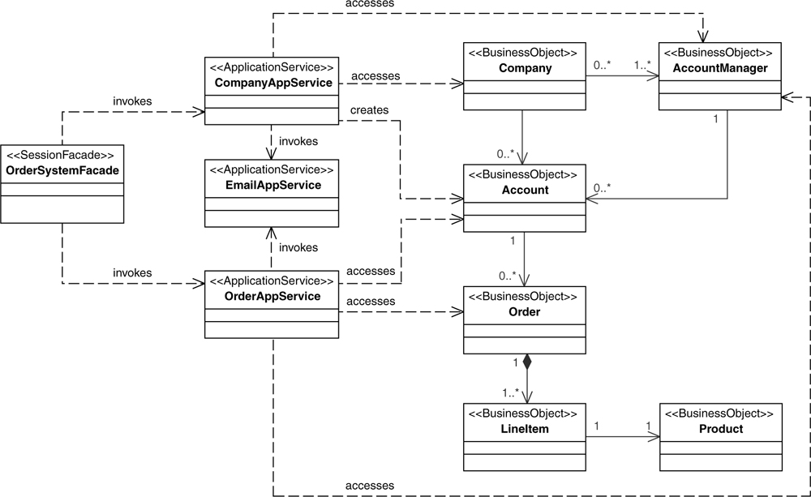
Business layer
Business purpose
Relationship between business objects and application services

Slide 140
Pattern subject of business
Consequences
  Advantages
    Promotes an object-oriented approach in the implementation of the business model.
    Centralizes business behavior, promoting reusability.
    Avoid code duplication

Slide 141
Pattern subject of business
  Inconveniences
    Adds an indirection layer
    Can produce "inflated" objects of functionality
    Persistence of these business objects

Slide 142
Pattern subject of business
Example code
public class Employee {
private int id;
private String name;
private long salary;
private Department department;
…………………
Department getDepartment()
{ return department; }
…………………

Slide 143
Pattern subject of business
public class Department {
private int id;
private String name;
private Collection<Employee> employees;
public int getId() {
return id; }
……………………………
public Collection<Employee> getEmployees() {
return employees;}
……………………………
}

Slide 144
Note
Reality
Domain model
Business with business objects
Resources
Customer
id: int
name: string
<!element customer (id, name, revCli)>
………
<!element reservation (id, name, cliRev)>
………
Ana
id
customer
1
name
Reservation
id: int
dateInput: string
nights:int
getClient(): Customer
cost(): float
…..
Customer
(0, n)
reservation
(1, 1)
Business with transfers
Reservation
TransferClient
id: int
name: String
nights
id
Relationships between reality, domain, business and resources
dateEntry
TransferReserve
id: int
dateInput: string
nights: int
idClient: int

Slide 145
Pattern subject of business
There is a fairly direct equivalence between:
  Domain and business model
  Tables and transfers
  The composite entities would be something like an intermediate view between the domain model and the model proposed by the transfers.

Slide 146
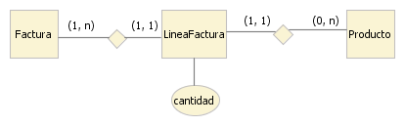
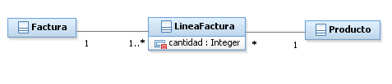
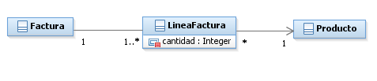

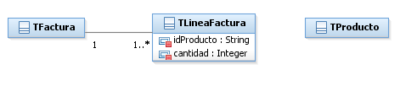
Pattern subject of business
Logical view
Business model
Domain model
Physical view
Composite Entity Model (JPA)
Relational model
Model transfers
Equivalences between different models

Slide 147
Domain store
Purpose
  You want to separate the persistence from the object model.
Also known as:
  Domain store
  Unit of work + Query object + Data mapper + Table data gateway + Dependent mapping + Domain model + Data transfer object + Identity map + Lazy load

Slide 148
Domain store
Motivation
  Many systems have a complex object model that requires sophisticated persistence strategies.
  These strategies should be independent of the business objects, so that they are not coupled with a specific warehouse.

Slide 149
Domain store
  Thus, four simultaneous problems must be solved:
    Persistence
    Dynamic load
    Transaction management
    Concurrence

Slide 150
Domain store
Context
  You want to omit persistence details in the business objects.
  The application could run in a web container
  The object model uses inheritance and complex relationships

Slide 151
Domain store
Solution
  Using a domain store to transparently persist an object model

Slide 152
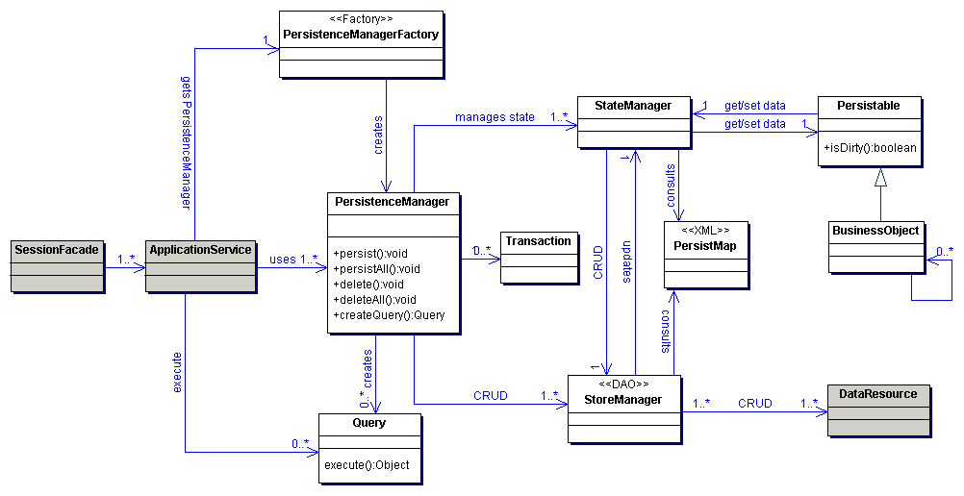
Description
Structure of the domain store pattern

Slide 153
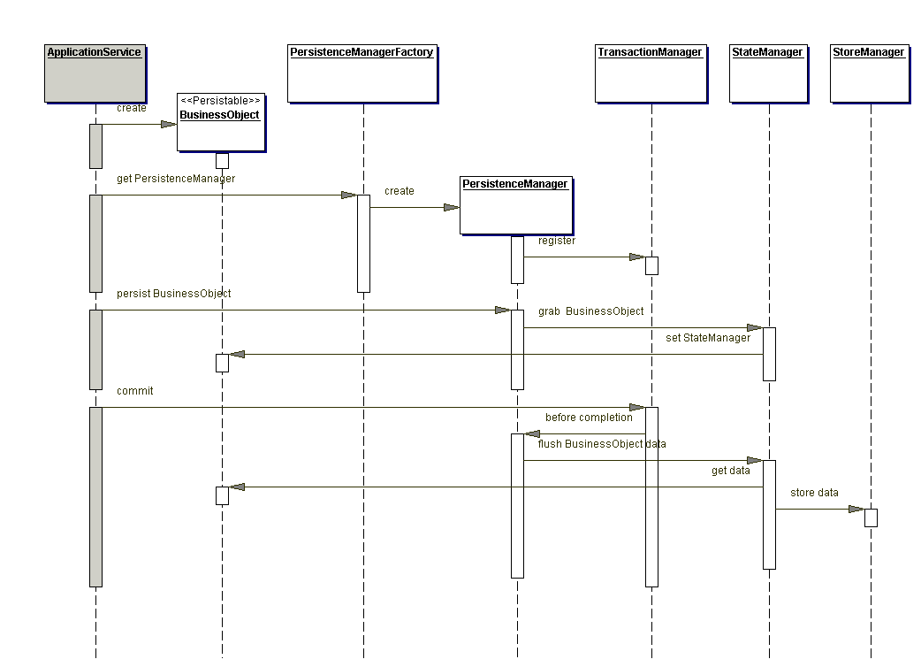
Persistence of a business object

Slide 154
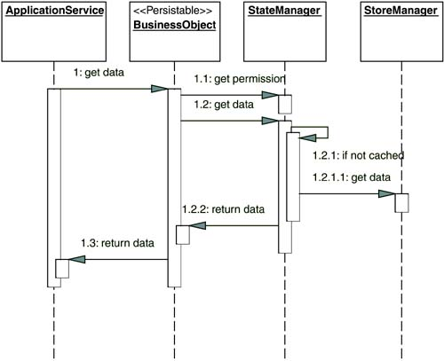
Domain store
Access to simple attributes of a business object

Slide 155
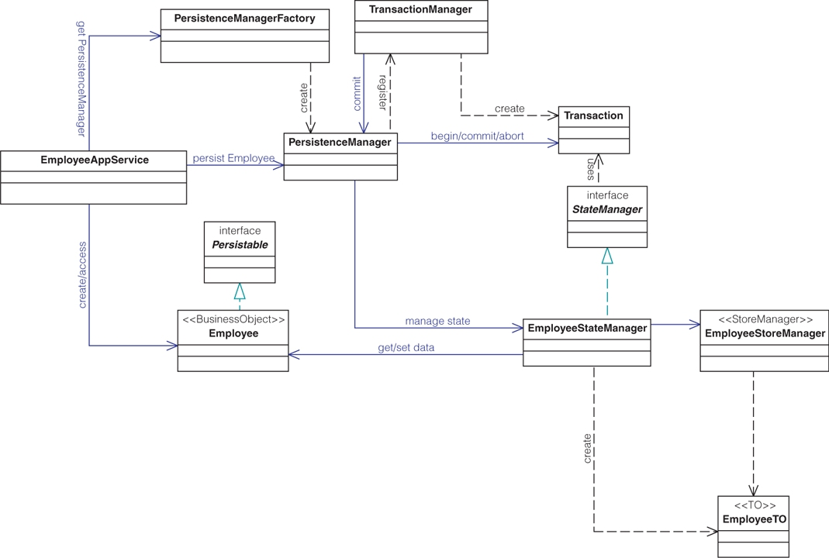
Structure of the domain store pattern

Slide 156
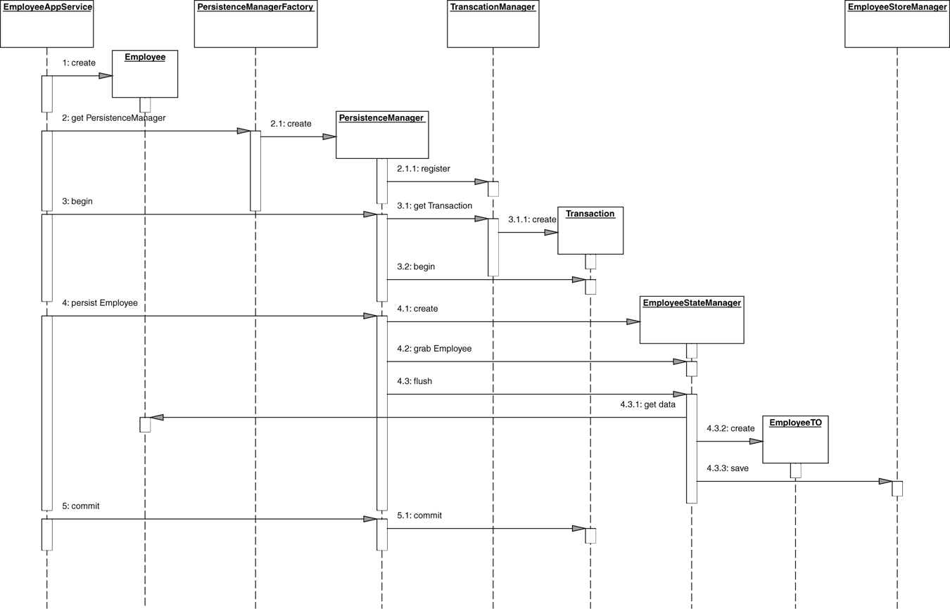
Interaction in the domain warehouse pattern

Slide 157
Note
Double package structure:
  Layers
  Modules
 | presentation | business | integration
users
copies
loans
searches

Slide 158
Design subsystems/code packages: layer-driven, with replicated modules
  presentation
    users
    copies
    loans
    searches
  business
    users
    copies
    loans
    searches
  integration
    users
    copies
    loans
    searches

Slide 159
Conclusions
This topic introduces the basic patterns of multilayer architecture.
We have seen a VERY basic multilayer. Missing:
  Business objects
  Dynamic load
  Concurrence
  Transactional

